Slide 1
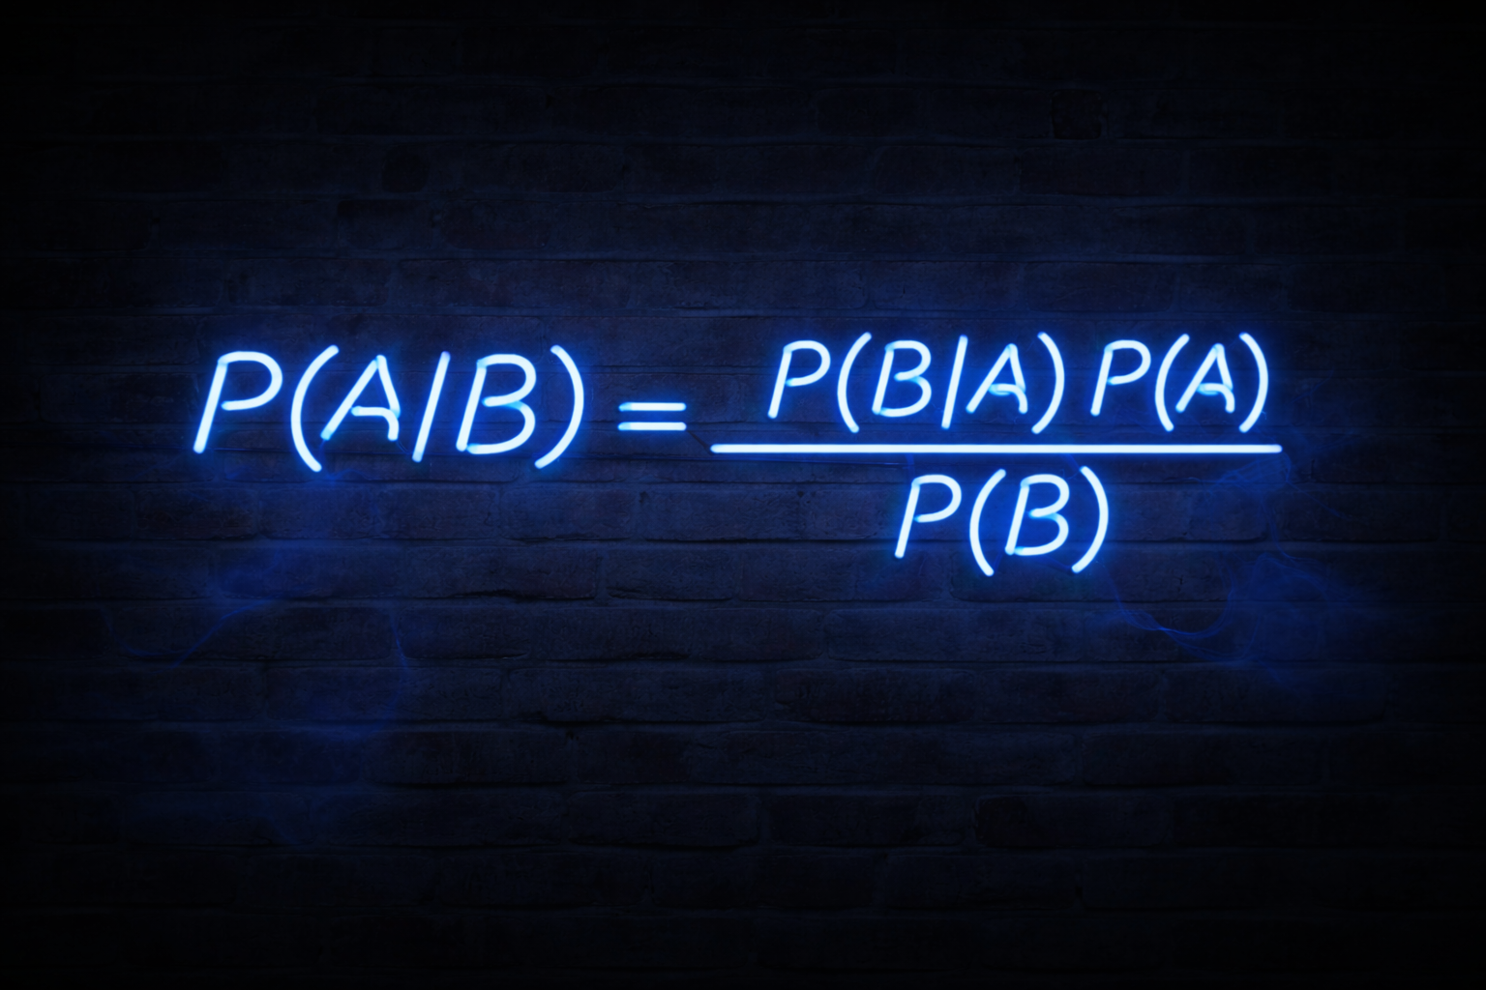

Slide 2
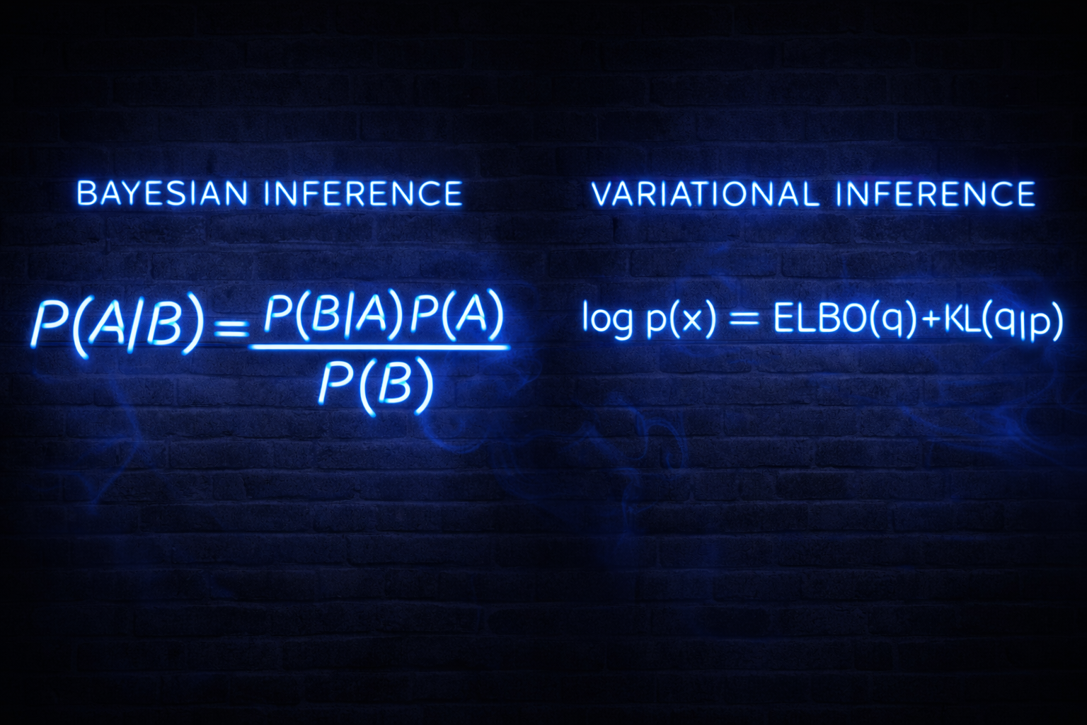

Slide 3
Under-dispersion in Variational Bayesian Inference
David Ewing
Masters of Applied Data Science
Supervisor: Dr John Holmes
School of Mathematics and Statistics
University of Canterbury
30 January 2026

Slide 4
What is Variational Inference?
Variational Inference (VI) is an optimisation technique for Bayesian inference.
Rather than computing the true posterior distribution directly (which is often intractable), VI approximates it by:
1. Choosing a tractable family of distributions Q
2. Finding the member of Q that best approximates the true posterior
3. Measuring 'best' using KL divergence

Slide 5
Variational Inference: Known Challenges
1. Under-dispersion (variance underestimation in posterior approximations)
2. Computational sensitivity (learning rate tuning, initialization dependence)
3. Local optima (convergence to suboptimal solutions)
4. Approximation quality (mean-field independence assumptions)
5. Coordinate ascent convergence (iteration requirements, convergence criteria)
6. Hyperparameter sensitivity (prior specification, penalty terms)
5. Additional approximation limitations (distributional family restrictions, structural constraints)
This presentation focuses specifically on: under-dispersion.

Slide 6
Two Approaches to Variational Inference
Fixed-Form Variational Bayes (FFVB)
Assumes a specific parametric form (e.g., Gaussian) for the entire posterior
Mean-Field Variational Bayes (MFVB)
Factorises the posterior into independent components
Enables closed-form updates for conditionally conjugate models
This presentation focuses exclusively on Mean-Field VB

Slide 7
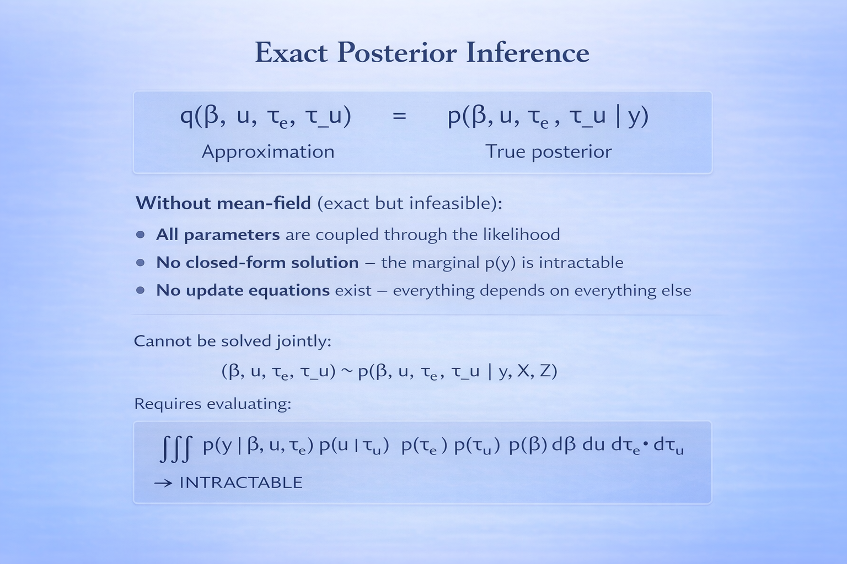

Slide 8
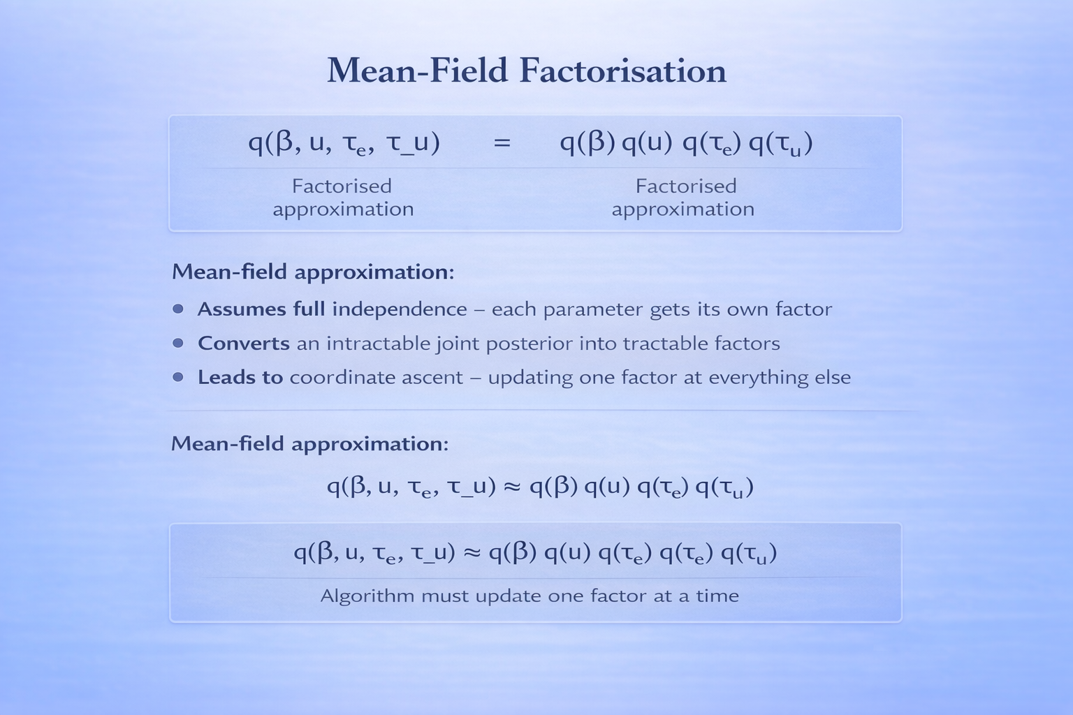

Slide 9
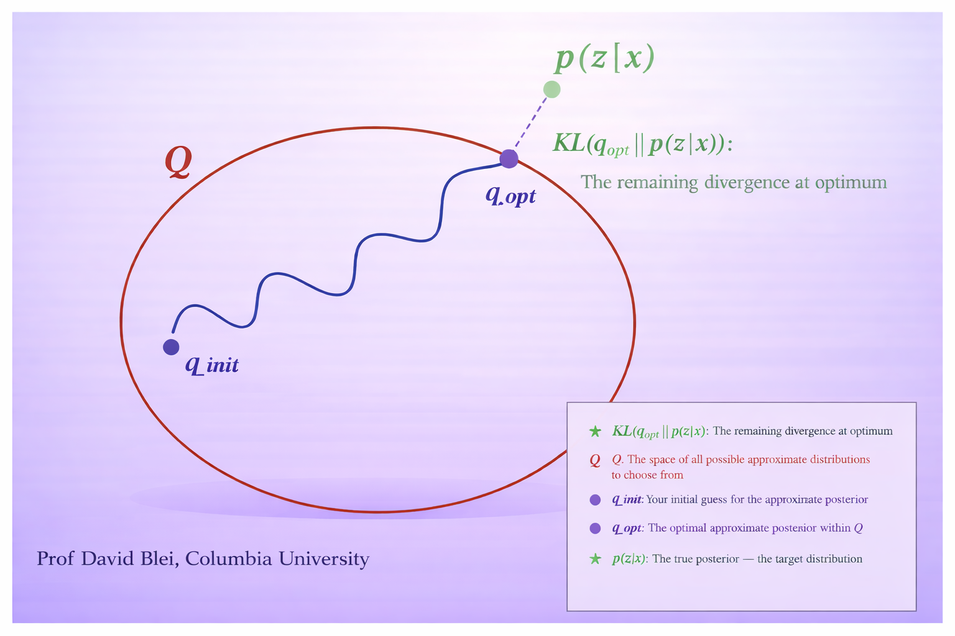

Slide 10
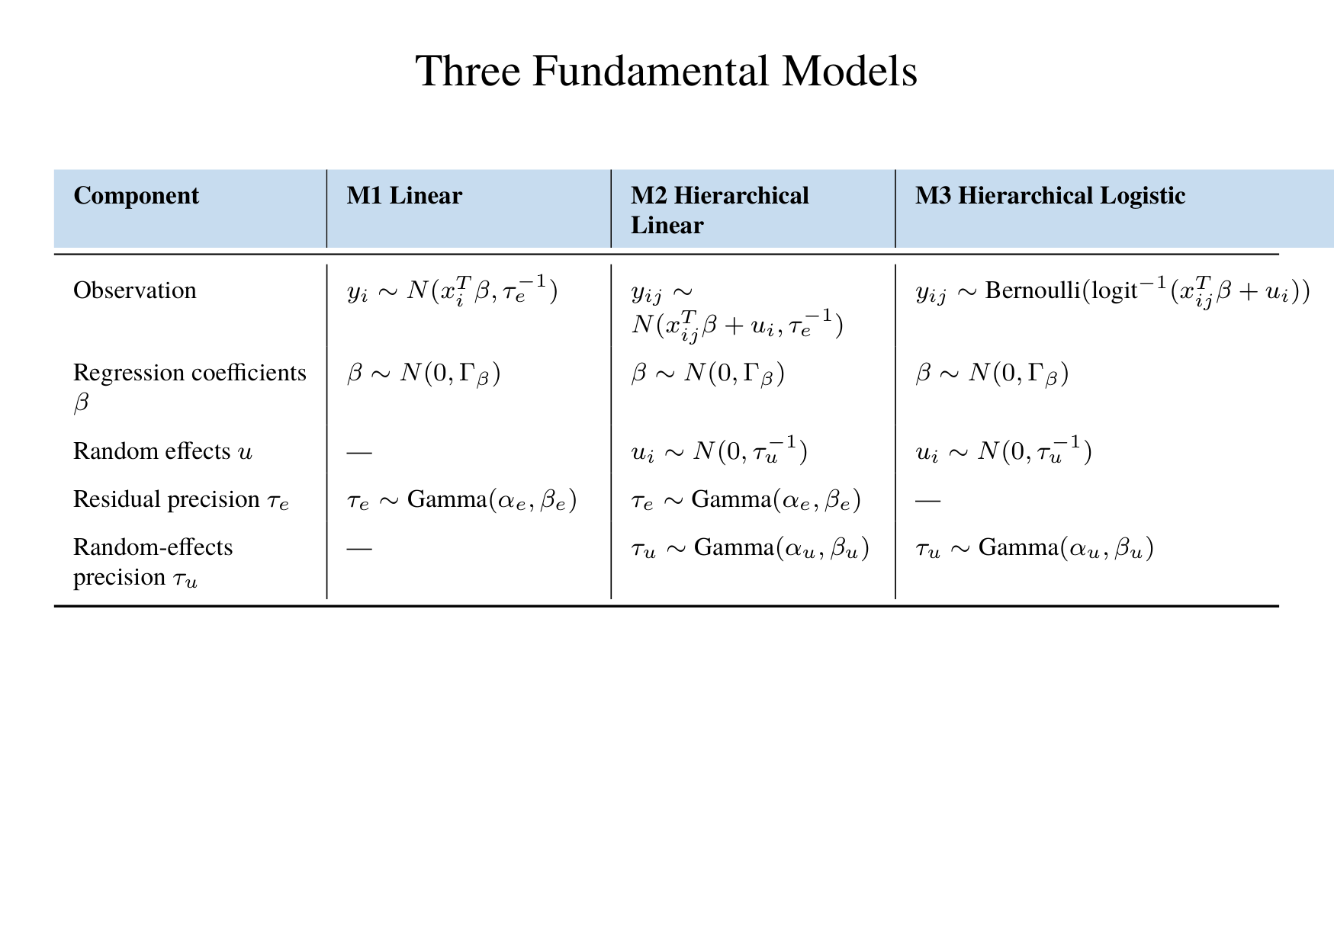

Slide 11
Testing Methodology
Comparison Strategy
• Model 1: Exact posterior (Normal-Inverse-Gamma) vs VB vs Gibbs
• Model 2: Gibbs sampling (MCMC/NUTS) as gold standard vs VB
• Varied group counts Q ∈ {5, 10, 20, 50, 100} to assess shrinkage effects
• Measured SD ratios (VB/Gibbs) to quantify under-dispersion
Important Note: Model 3 Implementation
Model 3 (hierarchical logistic) was implemented incorrectly and results are not reliable. Analysis focuses on Models 1 and 2.

Slide 12
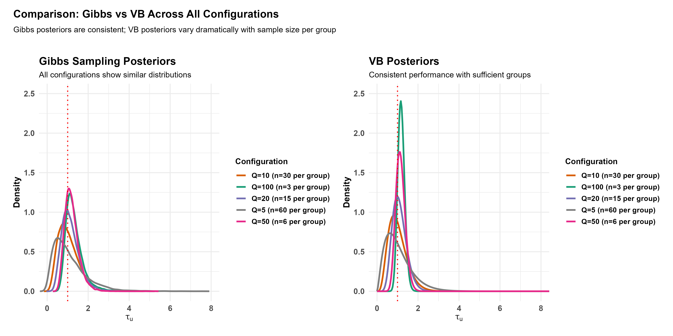

Slide 13
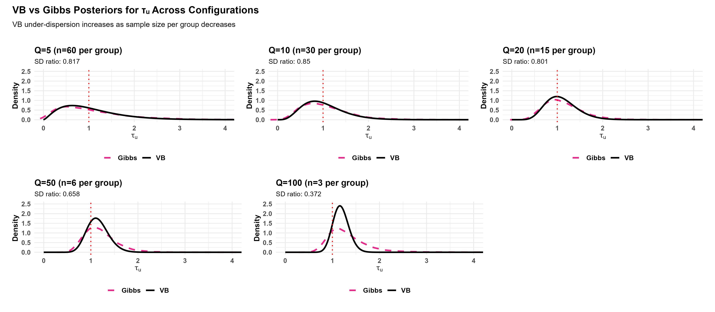

Slide 14
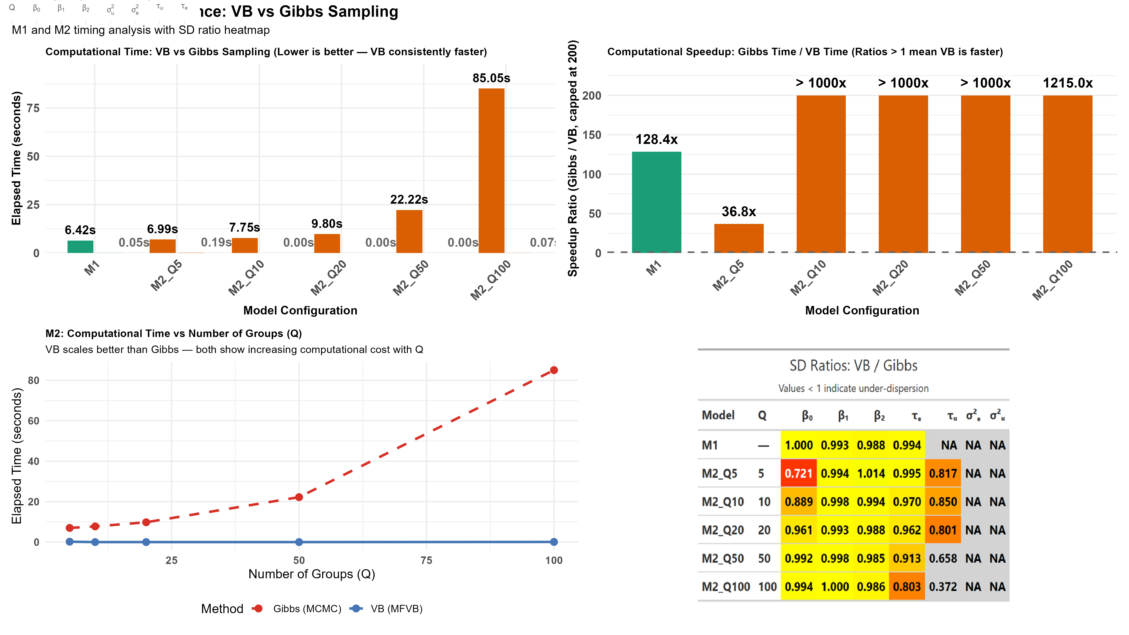

Slide 15
Model | Q | β₀ | β₁ | β₂ | τₑ | τᵤ | σ²ₑ | σ²ᵤ | What it means / Practical consequence | When it matters
M1 | — | 1.000 | 0.993 | 0.988 | 0.994 | NA | NA | NA | All β near 1.0 = excellent: Fixed effects highly reliable for predictions | Trust for all inference
M2_Q5 | 5 | 0.721 | 0.994 | 1.014 | 0.995 | 0.817 | NA | NA | β₀=0.721 (28% too narrow), τᵤ=0.817 (18% too narrow): Intercept unreliable; severely underestimates group differences | Do not trust for between-group questions
M2_Q10 | 10 | 0.889 | 0.998 | 0.994 | 0.970 | 0.850 | NA | NA | β₀=0.889 (11% too narrow), τᵤ=0.850 (15% too narrow): Moderate under-dispersion in intercept and group variation | Use caution for variance component inference
M2_Q20 | 20 | 0.961 | 0.993 | 0.988 | 0.962 | 0.801 | NA | NA | τᵤ=0.801 (20% too narrow): Group variation underestimated | Important concern for hierarchical inference
M2_Q50 | 50 | 0.992 | 0.998 | 0.985 | 0.913 | 0.658 | NA | NA | τᵤ=0.658 (34% too narrow): Serious under-dispersion in group variance | Major problem for between-group uncertainty
M2_Q100 | 100 | 0.994 | 1.000 | 0.986 | 0.803 | 0.372 | NA | NA | τᵤ=0.372 (63% too narrow): Catastrophic under-dispersion | Never use VI for this parameter - use HMC

Slide 16
Conclusion: Variational Bayes Trade-offs
Key Findings:
• VB achieves 100–1200× speedup over Gibbs sampling
• Fixed effects (β) estimates: Excellent accuracy
• Variance components (τᵤ, σ²ᵤ): Systematic under-dispersion
• Under-dispersion worsens with fewer observations per group
Practical Guidance:
• Use VB for: Fixed effects, large-scale problems, initial exploration
• Use Gibbs/HMC for: Variance components, hierarchical uncertainty, final inference
Active Research:
• Structured variational approximations (Blei et al., 2017)
• Expectation propagation methods
• Hybrid VB-MCMC approaches
• Adaptive variational families

Slide 17
References
Blei, D. M., Kucukelbir, A., & McAuliffe, J. D. (2017). Variational inference: A review for statisticians. Journal of the American Statistical Association, 112(518), 859–877.
Holmes, J. (2024). Fixed-form and mean-field variational Bayes approaches. Unpublished manuscript.
Stan Development Team. (2024). Stan: A probabilistic programming language. Retrieved from http://mc-stan.org
For more information on under-dispersion in hierarchical models, see course materials and Dr. Holmes' recent work on cascade effects in variance component estimation.

Slide 18
Thank You
Dr John Holmes
Supervisor
School of Mathematics and Statistics
University of Canterbury

